Slide 1


KS4 Mathematics
A9 Using Graphs to Solve Equations

Slide 2

Using graphs to solve equations
Solve the equation 2x² – 5 = 3x using graphs.
We can do this by considering the left-hand side and the right-hand side of the equation as two separate functions.
2x² – 5 = 3x
y = 2x² – 5
y = 3x
The points where these two functions intersect will give us the solutions to the equations.
Notes:
This can be compared with solving simultaneous equations. The difference is that we are only interested in the x-value in the coordinates of the crossing points.

Slide 3
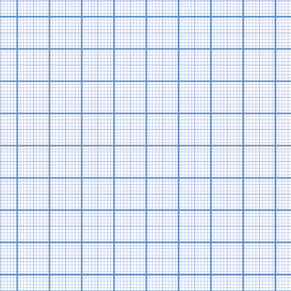
Using graphs to solve equations
y = 2x² – 5
The graphs of
y = 2x² – 5 and y = 3x intersect at the points:
10
y = 3x
8
(2.5, 7.5)
6
(–1, –3)
4
and (2.5, 7.5).
2
The x-value of these coordinates give us the solution to the equation 2x² – 5 = 3x as
–4
–3
–2
–1
0
1
2
3
4
–2
(–1,–3)
–4
x = –1
–6
and x = 2.5
Notes:
Stress again that, unlike simultaneous equations where we want the values of both x and y, when solving an equation in x we are only interested in the x-values in the coordinates.

Slide 4
Using graphs to solve equations
Solve the equation 2x² – 5 = 3x using graphs.
Alternatively, we can rearrange the equation so that all the terms are on the right-hand side,
2x² – 3x – 5 = 0
y = 2x² – 3x – 5
y = 0
The line y = 0 is the x-axis. This means that the solutions to the equation 2x² – 3x – 5 = 0 can be found where the function y = 2x² – 3x – 5 intersects with the x-axis.
Notes:
Ask pupils to tell you what is special about the line y = 0 before revealing that it is the x-axis.

Slide 5
Using graphs to solve equations
10
y = 2x² – 3x – 5
The graphs of
y = 2x² – 3x – 5 and y = 0 intersect at the points:
8
6
(–1, 0)
4
and (2.5, 0).
2
The x-value of these coordinates give us the same solutions
(–1,0)
(2.5, 0)
y = 0
–4
–3
–2
–1
0
1
2
3
4
–2
x = –1
–4
and x = 2.5
–6
Notes:
Finding graphical solutions to quadratic equations is also explored in A6.1.

Slide 6
Using graphs to solve equations
Solve the equation x³ – 3x = 1 using graphs.
This equation does not have any exact solutions and so the graph can only be used to find approximate solutions.
A cubic equation can have up to three solutions and so the graph can also tell us how many solutions there are.
Again, we can consider the left-hand side and the right-hand side of the equation as two separate functions and find the x-coordinates of their points of intersection.
x³ – 3x = 1
y = x³ – 3x
y = 1
Notes:
Discuss the limitations of this method for equations that do not have exact solutions (that is, when the solutions are irrational numbers).
The main benefit in using a graph is to find out how many solutions there are and what values they lie between. We can then find more accurate solutions using an other method such as trial and improvement.

Slide 7
Using graphs to solve equations
y = x³ – 3x
The graphs of y = x³ – 3x and y = 1 intersect at three points:
10
8
6
This means that the equation x³ – 3x = 1 has three solutions.
4
2
y = 1
Using the graph these solutions are approximately:
–4
–3
–2
–1
0
1
2
3
4
–2
x = –1.5
–4
x = –0.3
–6
x = 1.9
Notes:
The solutions are given by the x-coordinate of each point of intersection.
The solutions given by the graph can be found to any number of decimal places using trial and improvement. This is demonstrated for the value between x = 1.8 and 1.9 in the next section.

